Slide 1
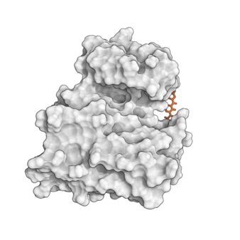
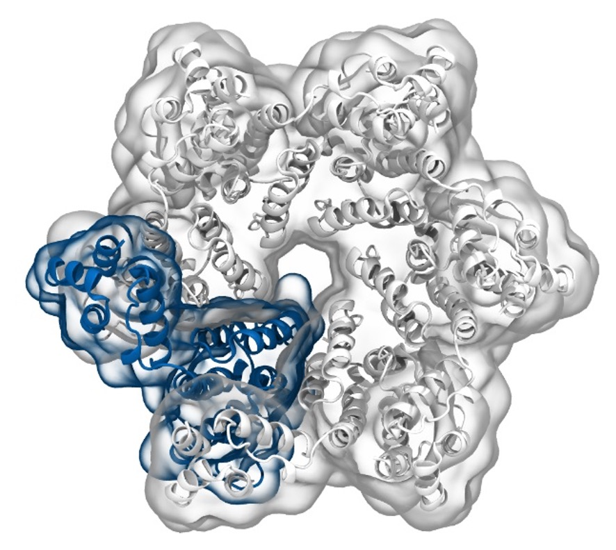
Simulation of Biomolecules
Docking
2024 CCP5 Summer School
Dr Matteo Degiacomi
Durham University
matteo.t.degiacomi@durham.ac.uk
Dr Antonia Mey
University of Edinburgh
antonia.mey@ed.ac.uk

Slide 2
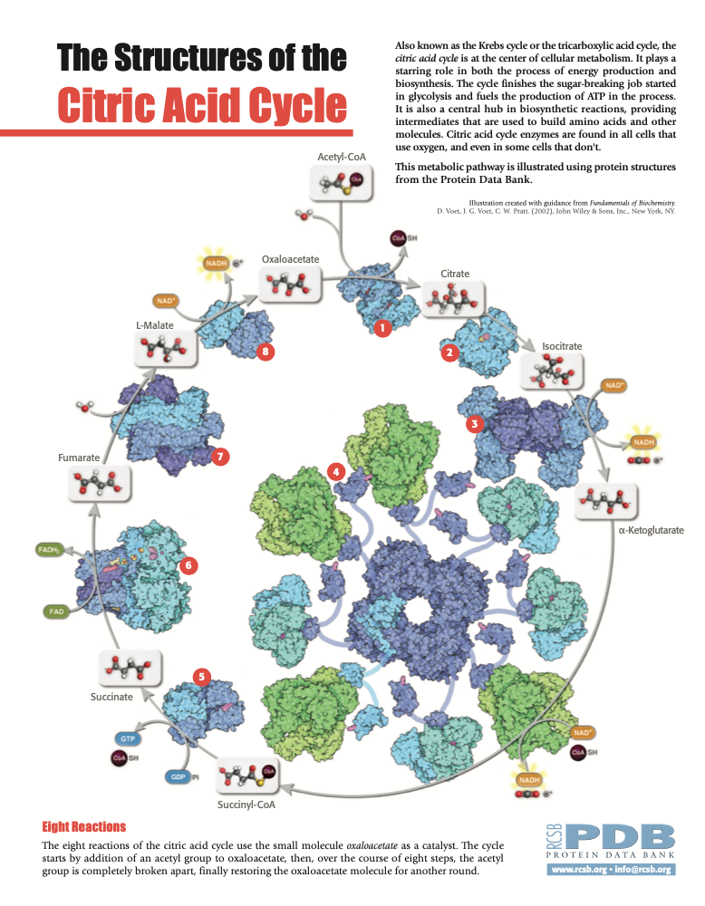
Life is built on protein and small molecule interactions
Small molecules are:
substrates of enzymes
Inhibitors or activators
Co-factors
And play an important role in life.
Accurate interaction prediction is essential.
2

Slide 3
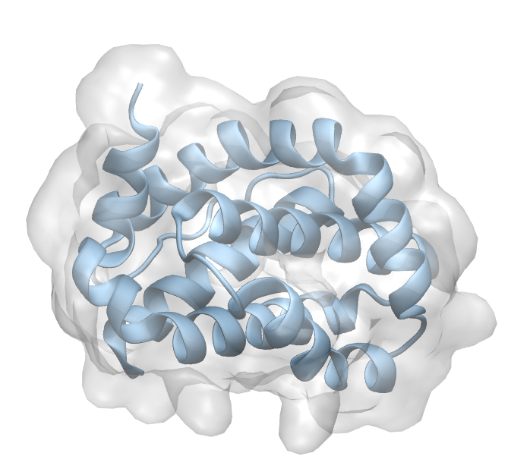
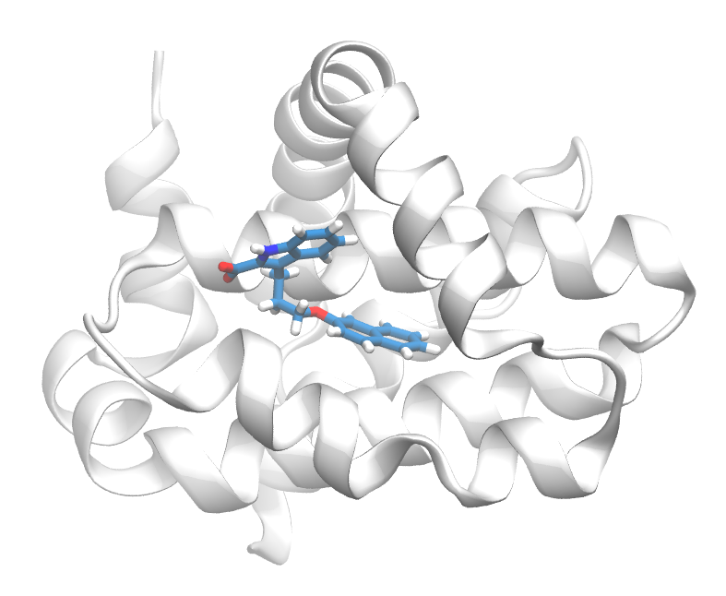
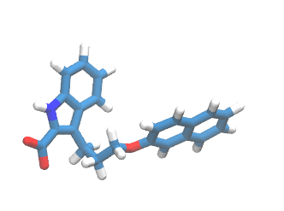
What is docking?
The process of predicting a stable 3D geometry of an interacting pair of molecules – a binding mode/pose.
Ligand:
Receptor:
Binding pose:
+
=
3

Slide 4
Nomenclature
Ligand: Structure (usually a small molecule) that binds to the binding site.
Receptor: Structure (usually a protein) that contains the active binding site.
Binding site: Set of aminoacids (residues) that physically interact with the lingad (usually within 6 Ångstroms).
4

Slide 5
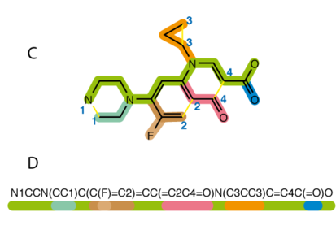
Typical workflow
1-D or 2-D ligand structure
Find Pocket
Search
+
Scoring Function
Protein structure
Docking Assessment
5

Slide 6
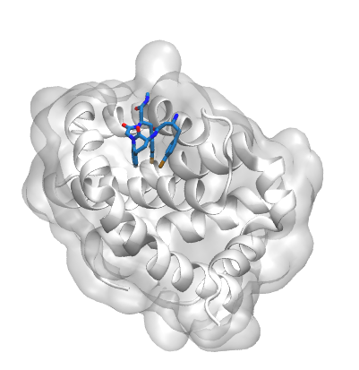
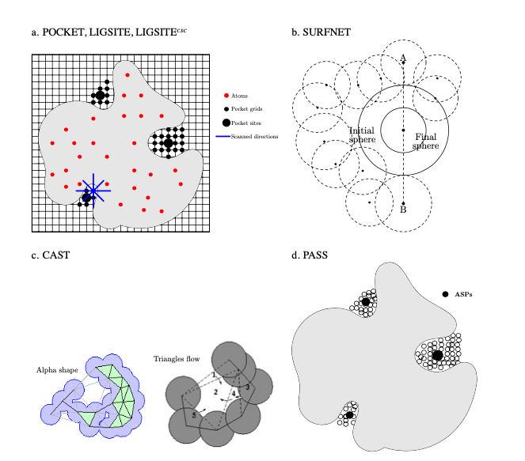
Finding a pocket
PDB:5KU9
Using a reference atomic structure with an existing molecule bound
Using a pocket finding algorithm
BMC Structural Biology 2006, 6:19 doi:10.1186/1472-6807-6-19
6

Slide 7
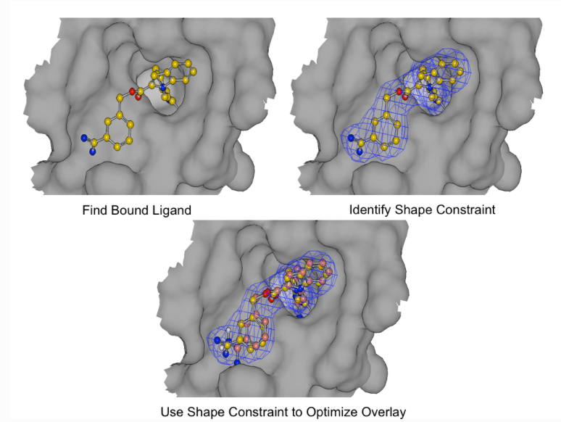
Shape based methods
With an existing ligand it is possible to match the shape and optimize the overlay
Fast and robust
Ligand changes are not taken into account
https://docs.eyesopen.com/applications/oedocking/theory/posit_theory.html#posit-heat-map
7

Slide 8
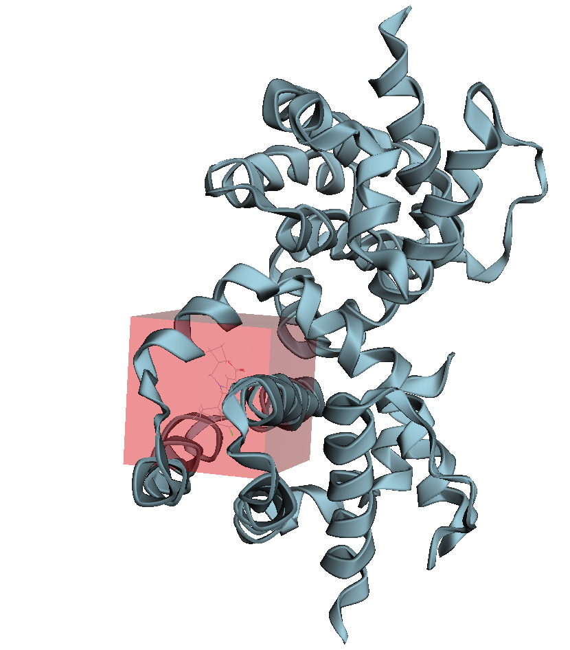
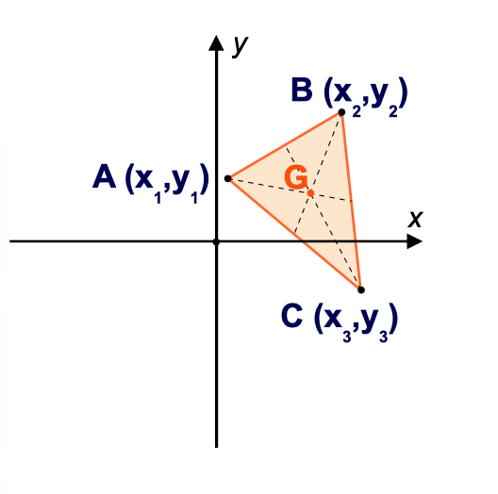
Finding the docking grid area
Often you have a ligand template or binding site residue to help with designing the docking grid
Use centre of geometry of a molecule from X-ray
8

Slide 9
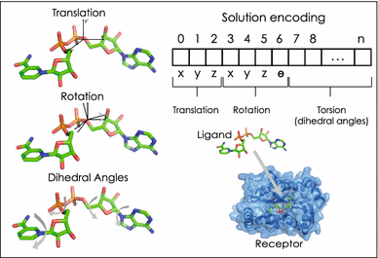
Genetic algorithm for ligand conformers
Testing different arrangements of the ligand in the rigid binding site of the protein
9

Slide 10
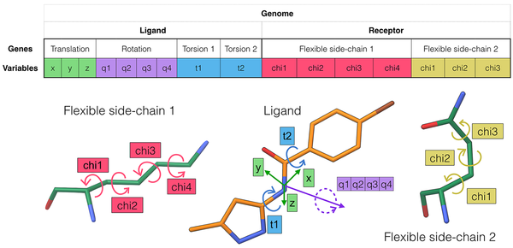
Allowing protein and ligand flexibility is often better
10

Slide 11
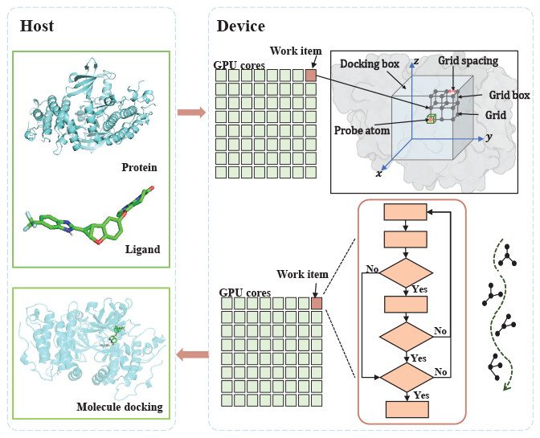
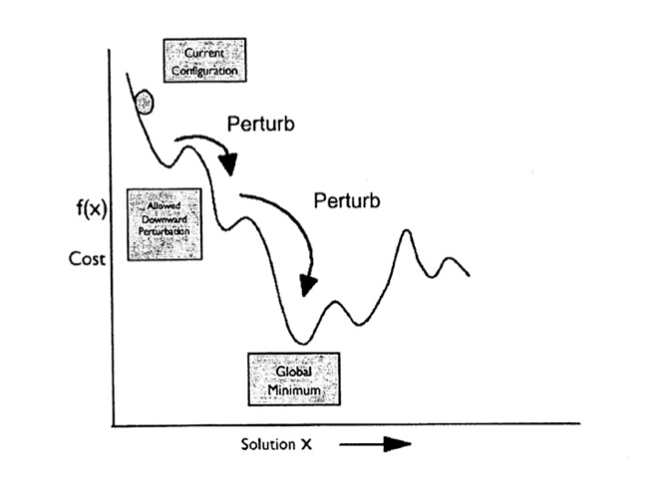
Flexibility increases compute time
Simulated annealing
N=T360/i
N: number of conformations
T: number of rotable bonds
I: incremental degrees
Typical drug molecule
10 rotable bonds 30º increments (discrete)
10¹² plausible conformations!
J. Chem. Inf. Model. 2023, 63, 7, 1982–1998
https://sgt.cnag.cat/www/presentations/files/slides/20110112_Docking.pdf
11

Slide 12
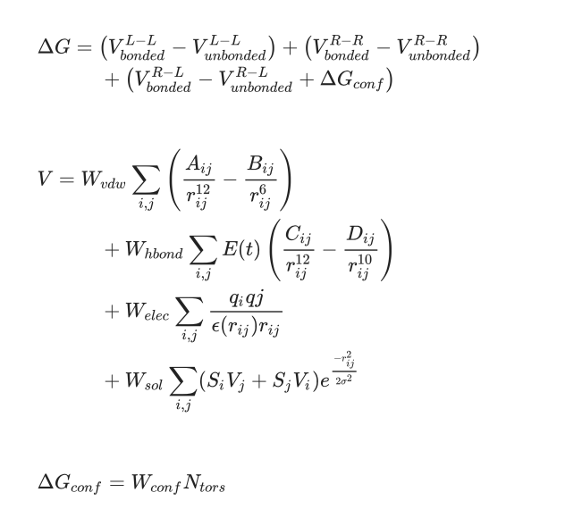
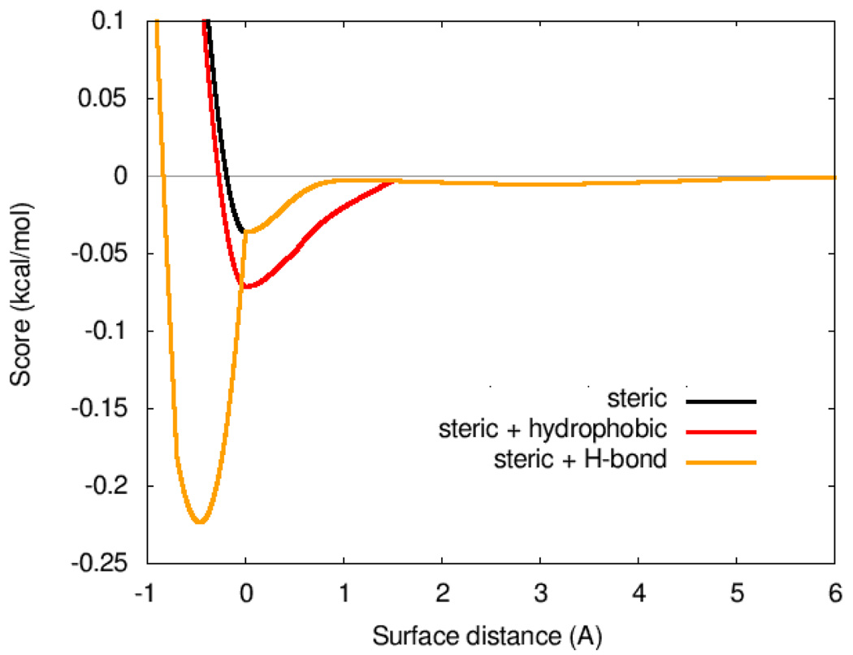
Scoring functions
Weight | Term
−0.0356 | gauss₁
−0.00516 | gauss₂
0.840 | repulsion
−0.0351 | hydrophobic
−0.587 | hydrogen bonding
0.0585 | N_{rot}
Scoring functions can be used beyond shape optimization to optimize ligand and protein interactions
J Comput Chem. 2010 Jan 30; 31(2): 455–461.
Soft Comput 23, 4155–4176 (2019).
12

Slide 13
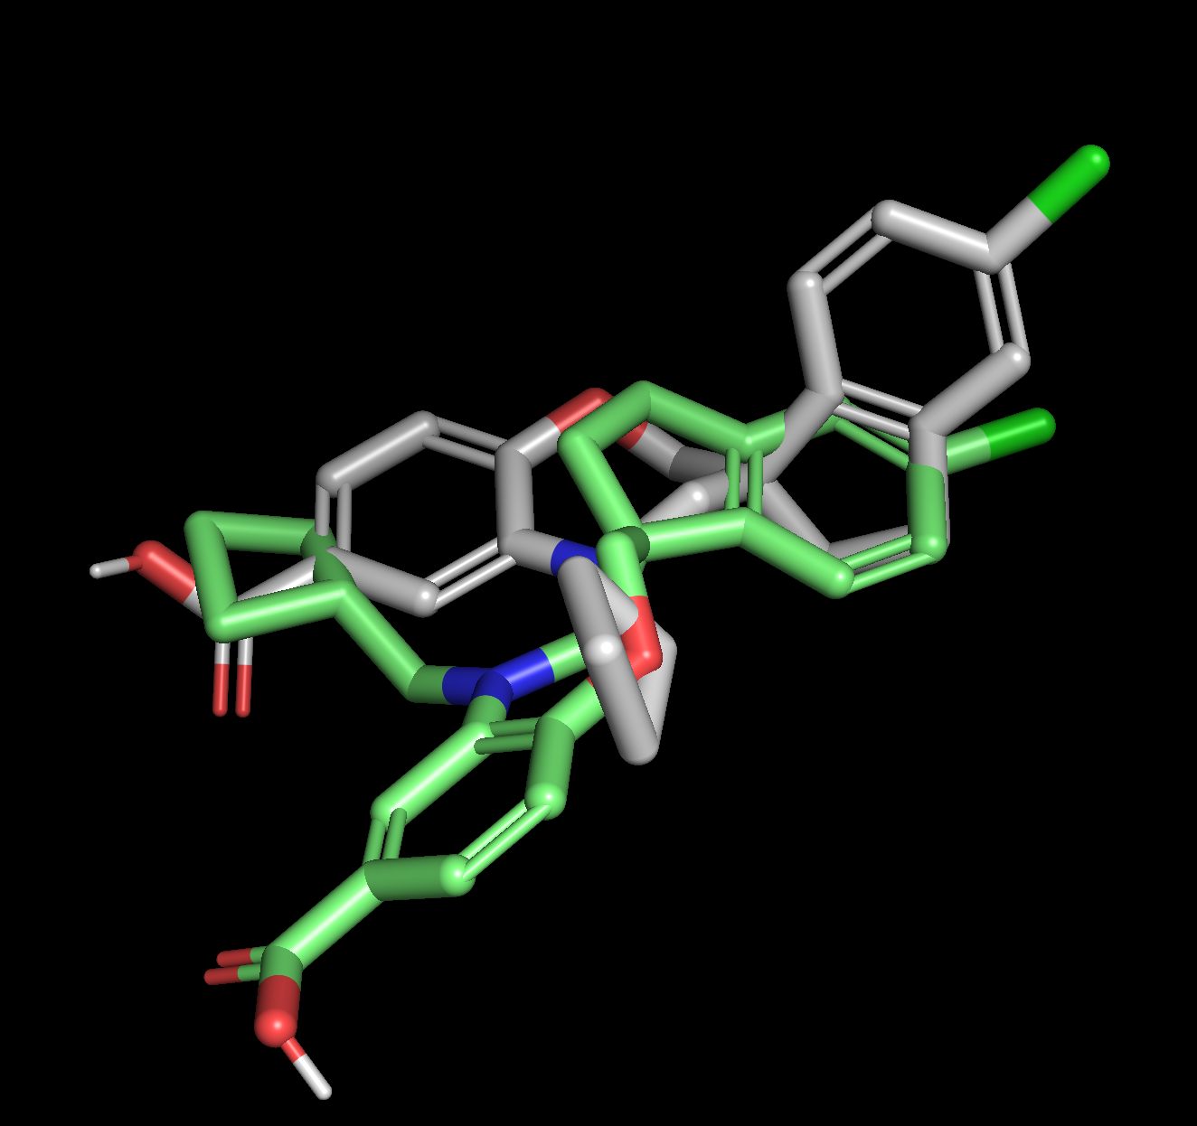
Typical docking output generates multiple poses
mode | affinity | dist from best mode
| (kcal/mol) | rmsd l.b.| rmsd u.b.
-----+------------+----------+----------
1 -8.36 0 0
2 -8.08 2.899 6.789
3 -7.985 3.643 7.852
4 -7.914 3.415 5.21
5 -7.765 2.167 2.826
13

Slide 14
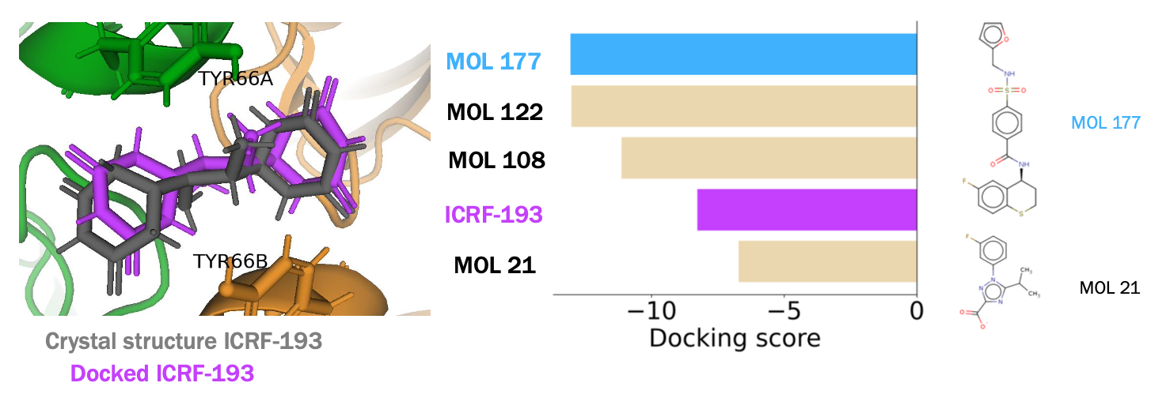
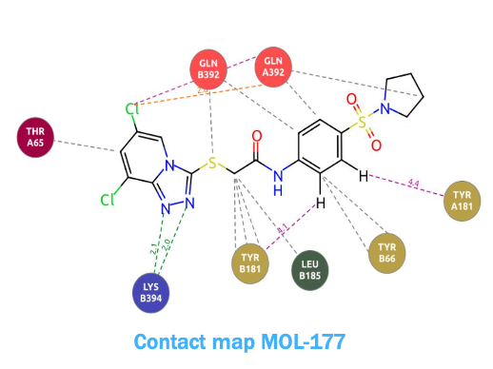
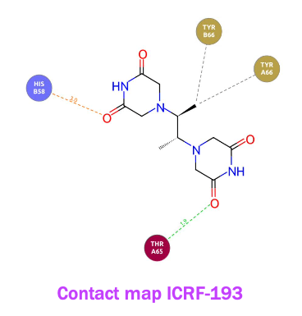
Evaluating Docked structures
14

Slide 15
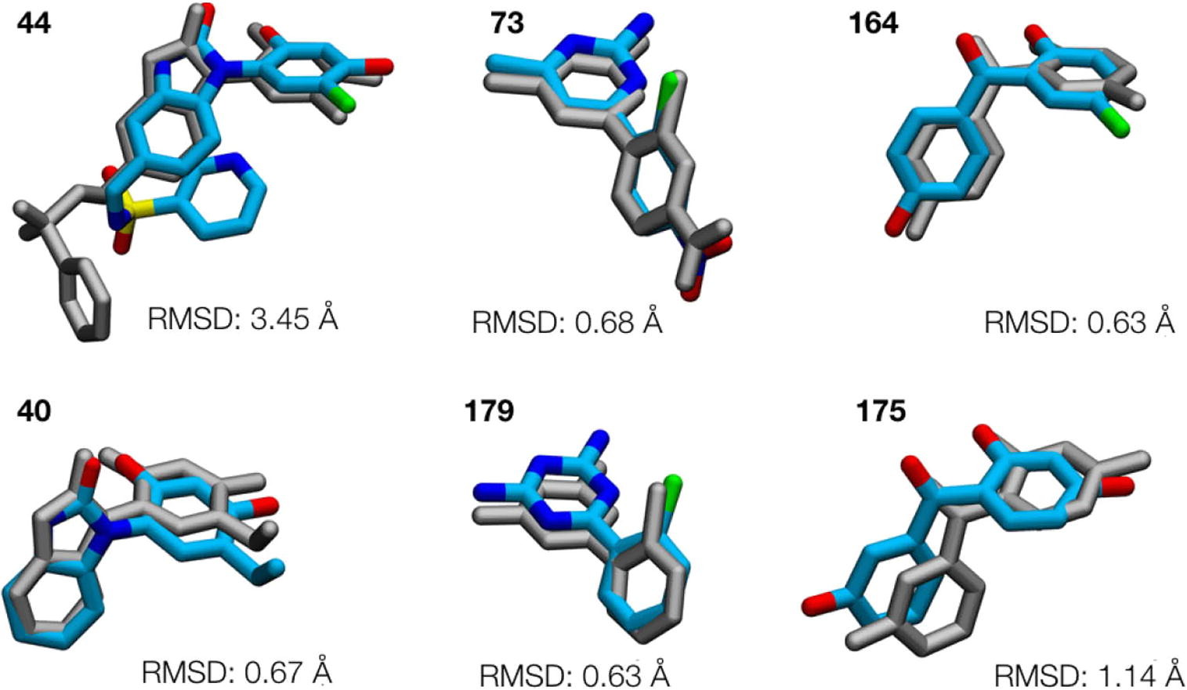
Evaluating the binding mode/pose
Bioorganic & Medicinal Chemistry
Volume 24, Issue 20, 15 October 2016, Pages 4890-4899
15

Slide 16
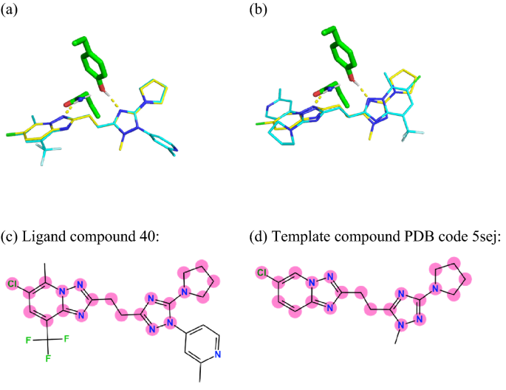
Template docking and cross docking improves docking
Dock the same ligand into multiple protein structures (X-ray, MD)
Generate multiple ligand conformers and dock into multiple structures
Use existing ligand data as a template or guide e.g. through Maximum common substructure
J Comput Aided Mol Des 36, 753–765 (2022)
16

Slide 17
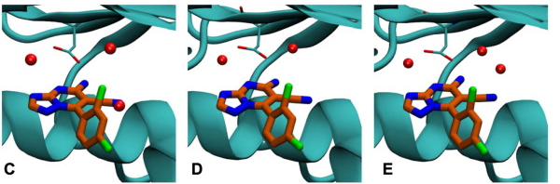
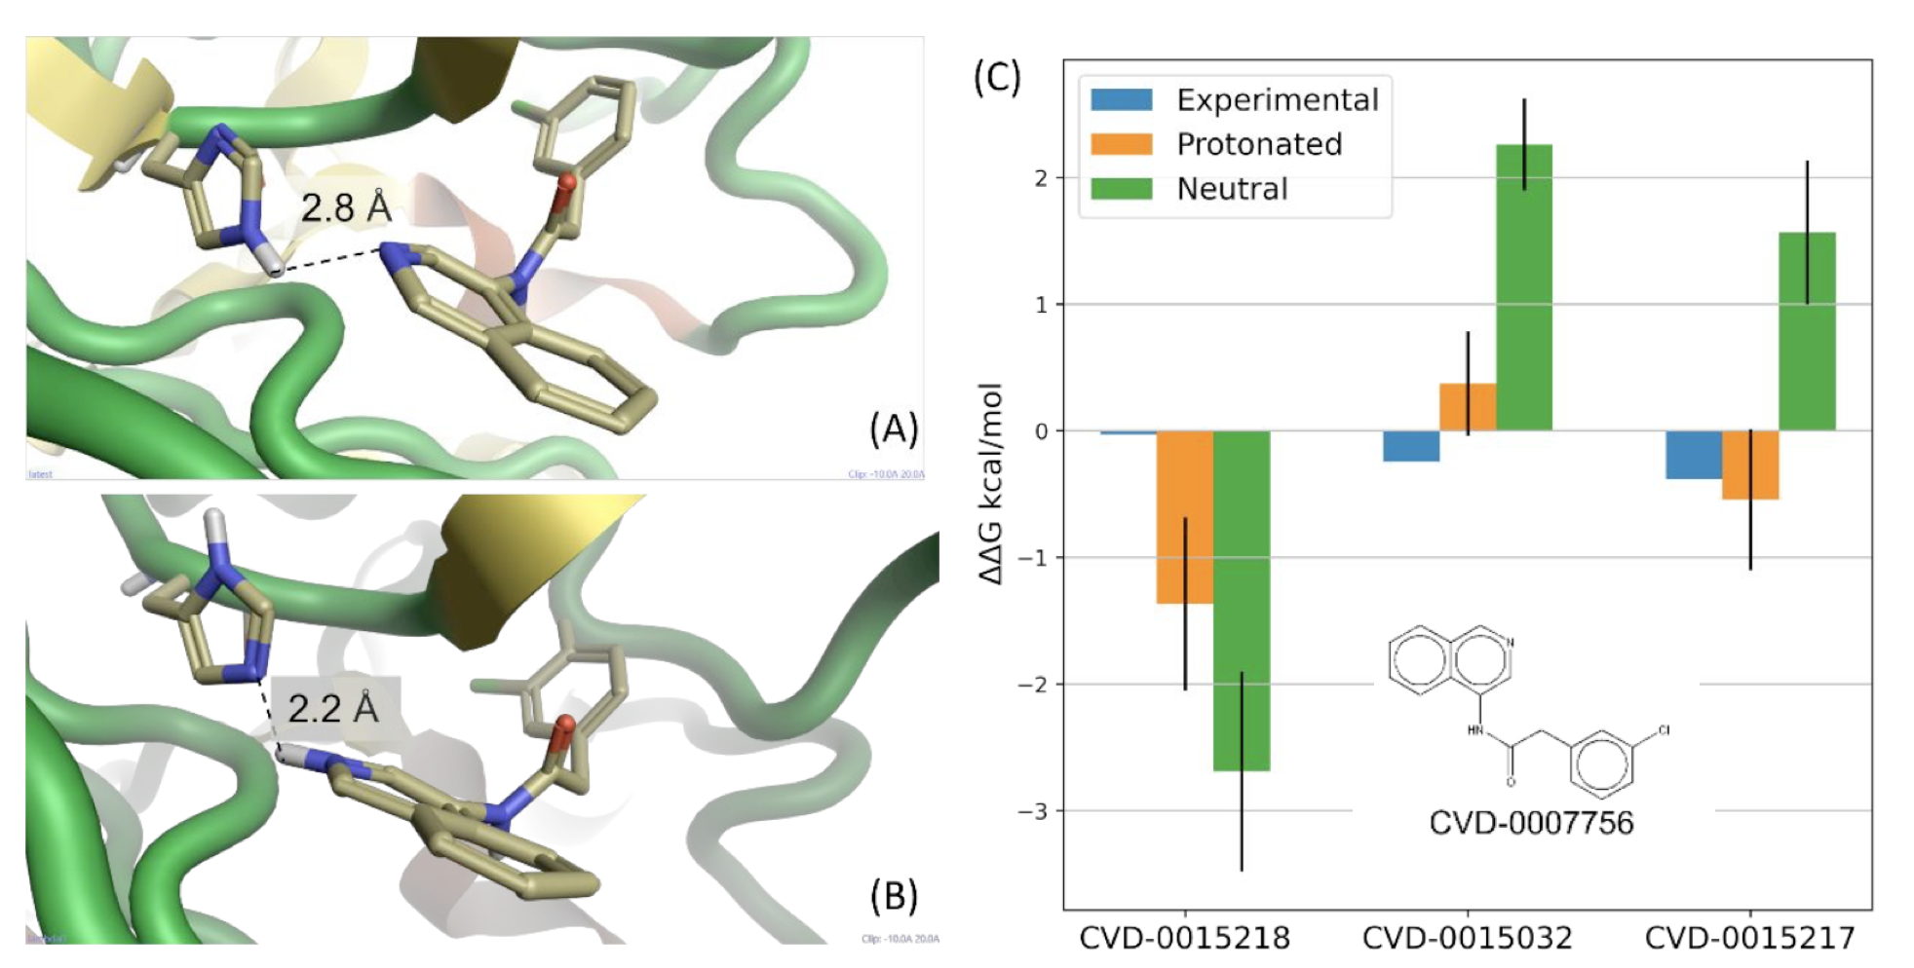
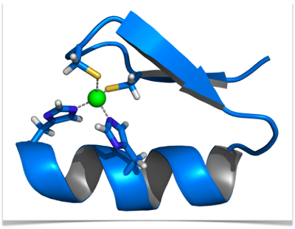
Things to worry about
pKa of ligands and binding site protonation need to be considered
Structural waters are important
Co-factors such as ions and other molecules are imporant
17
Notes:
C crystal water clash with docked structure, manually moved crystal water in E

Slide 18
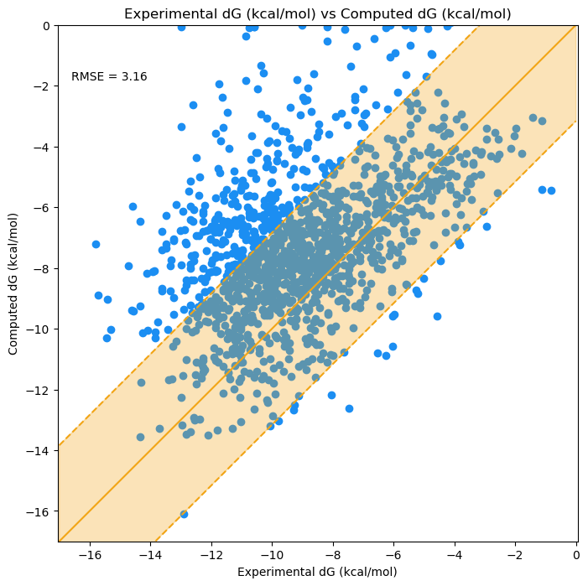
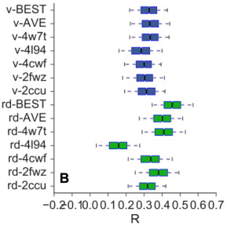
Comparing against experimental ΔG
Bulk assessment of correlation coefficient
18

Slide 19
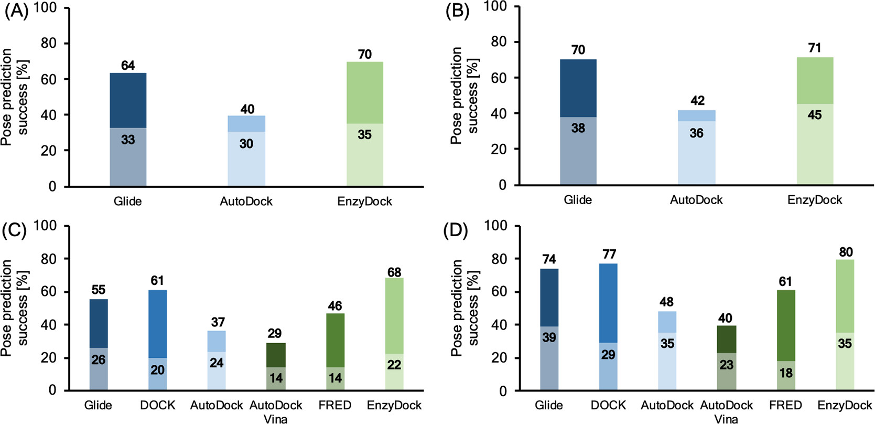
Recent docking benchmark
J. Chem. Inf. Model. 2021, 61, 6, 2957–2966
19
Notes:
Docking pose prediction success (%) for selected methods for 193 crystal structures of SARS-CoV-2 M^{pro}. For each column, the upper part represents the ability of methods to identify poses with rmsd < 2 Å, while the lower part represents ability of methods to identify a pose with rmsd < 2 Å as the lowest energy pose. (A) All 193 crystal structures, (B) 108 crystal structures with covalently bound ligands, (C) 85 crystal structures with noncovalently bound ligands, (D) 51 crystal structures with noncovalently bound ligands excluding surface bound ligands.

Slide 20
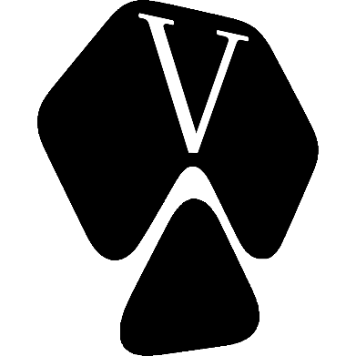








What tools exist for molecular docking?
Glide
Autodock Vina
And others….
20

Slide 21
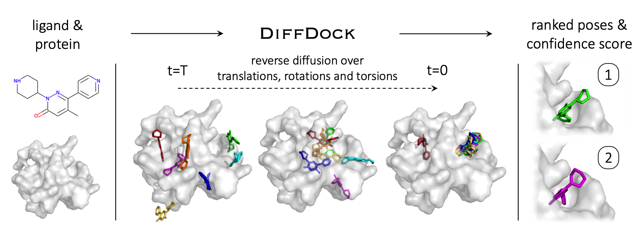
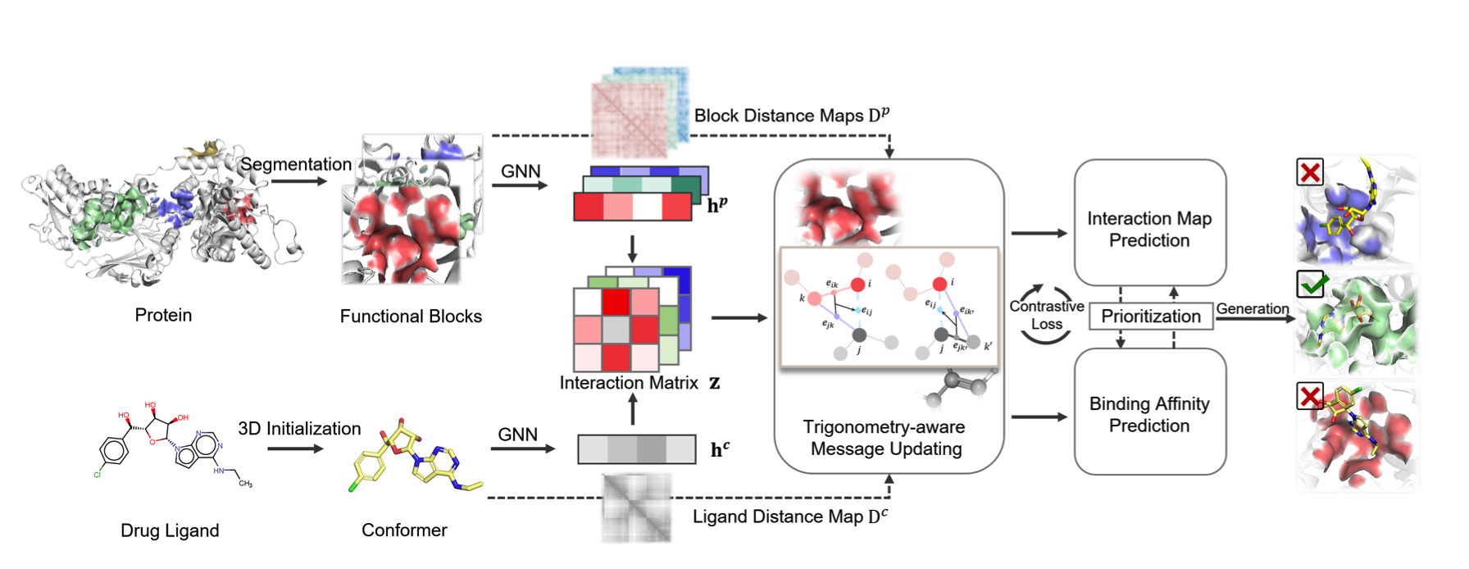
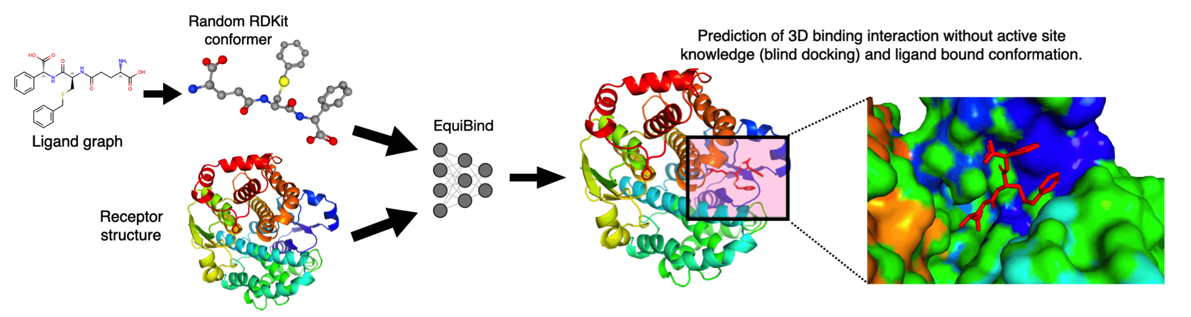
ML-based docking
Diffdock
TankBind
Equibind
Gnina
Deepdock
….
21

Slide 22
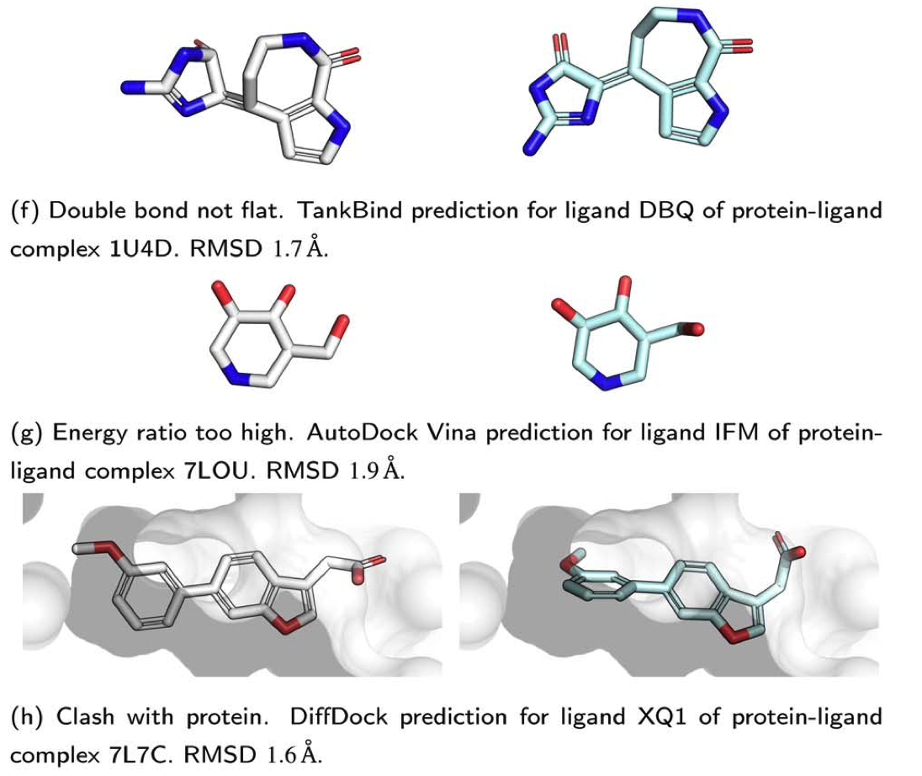
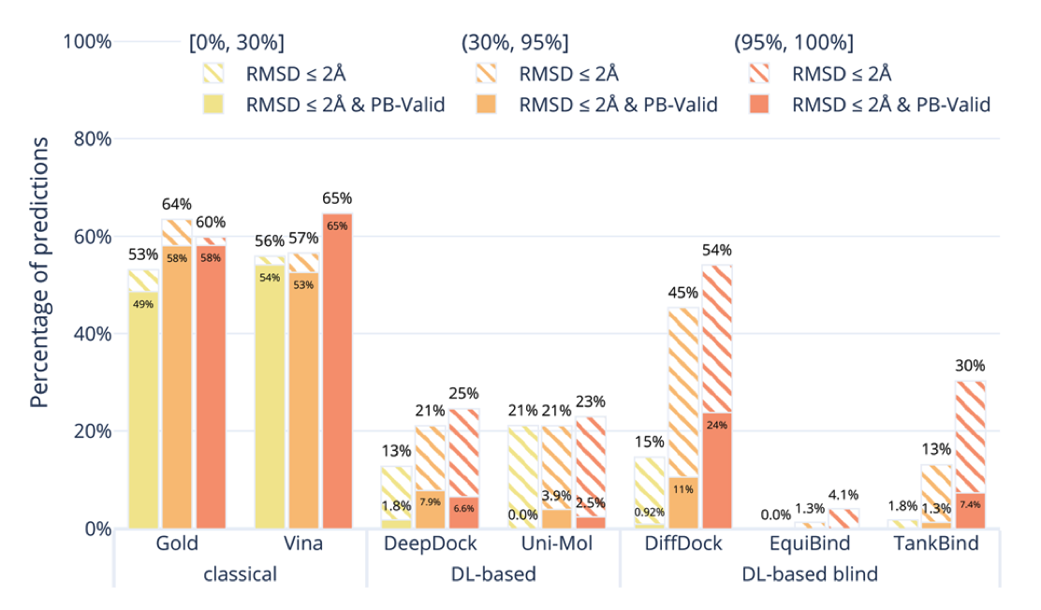
Evaluating the binding mode/pose of ML tools
PoseBuster: Chem. Sci., 2024,15, 3130-3139
22

